Slide 1
Last week

Slide 2
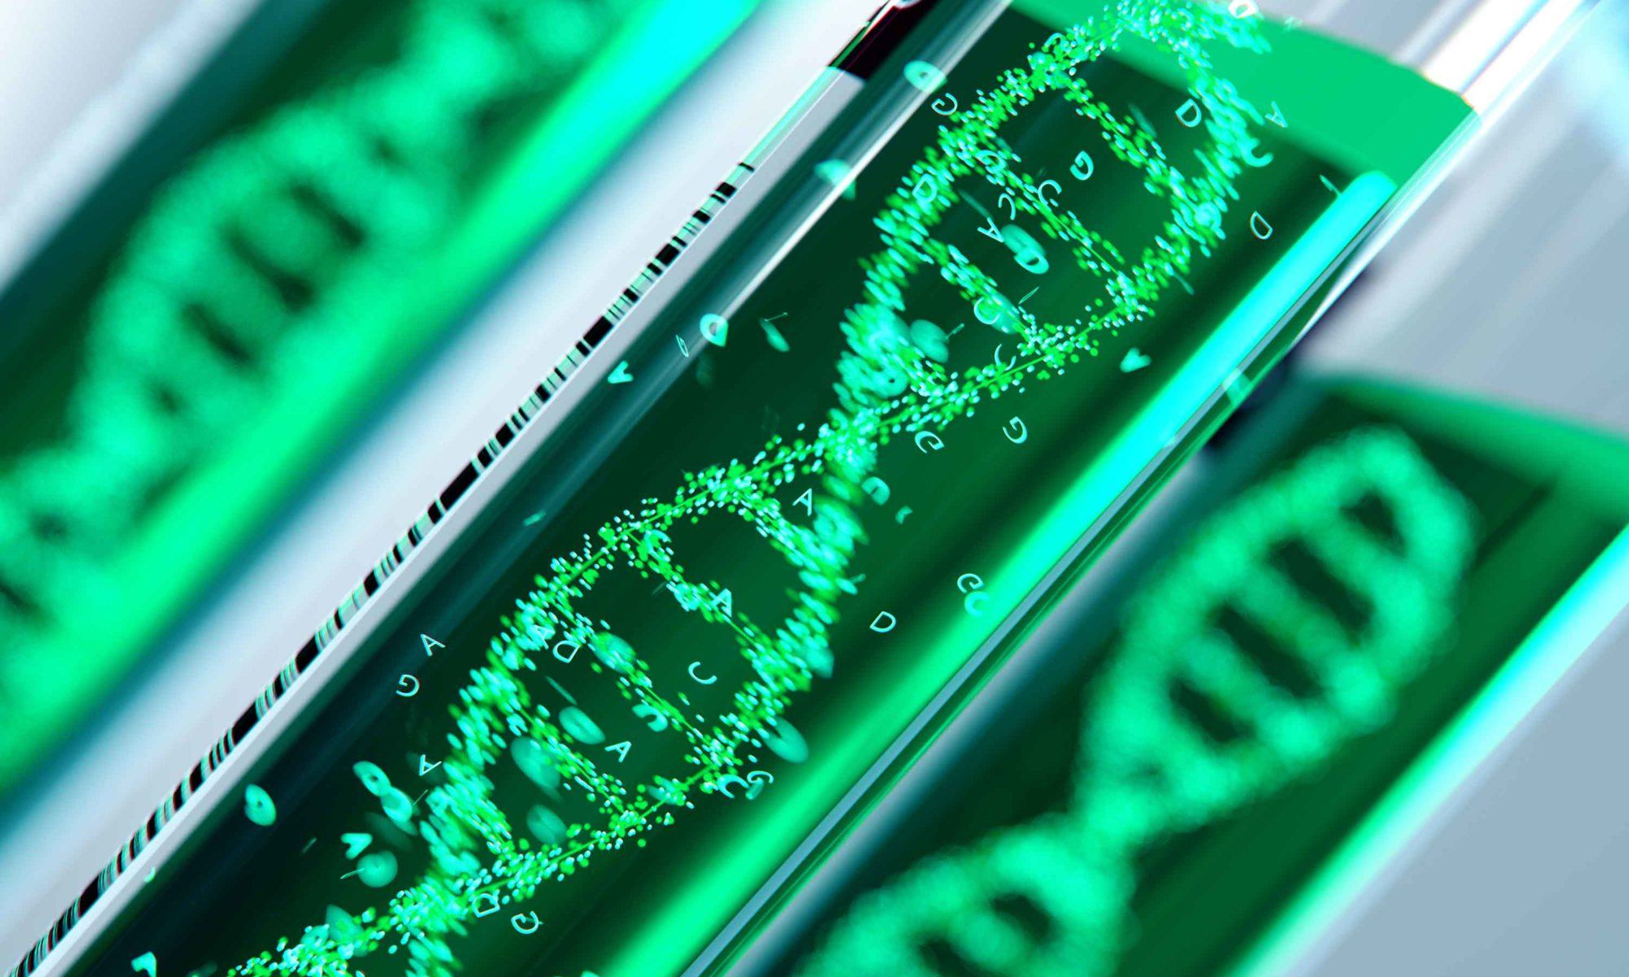
Drug Development & Finance
Alessandro Stasi
Notes:
One main issue in the biomedical sector is related to funding (i.e. payment structures) and financial risk and return of investments. In some cases, the financial considerations may have become too important, especially when they end up driving the scientific and medical agendas of biopharma companies. Shouldn't the science be driving the financing decisions, and not the other way around? But in too many cases, biopharma decision makers are not familiar with financial analysis. For this particular reason it is important to investigate the relationship between science and business in biotechnology.

Slide 3
OUTLINE
What is a drug?
Types of drugs
Breakthroughs In Biomedicine

Slide 4
1. What is a Drug ?

Slide 5
What is a drug?
Drugs are substances that affect the functions of living things and are administered to treat, prevent, or cure unwanted diseases and symptoms.
The United States Food and Drug Administration (FDA) regulates drug marketing, requiring manufacturers to prove their products to be safe, effective, and appropriately labeled.
Scientists start with simple, defined, model systems that enable them to identify potential drugs. These potential drugs are then tested in increasingly complex and real-world situations to prove their efficacy.

Slide 6
Enzymes /ˈɛnzaɪmz/ are proteins that act as biological catalysts (biocatalysts). Catalysts accelerate chemical reactions.
https://www.youtube.com/watch?v=yk14dOOvwMk
https://www.youtube.com/watch?v=PhfhMBO-w9Q
Notes:
Many drug molecules are enzyme inhibitors, so their discovery and improvement is an active area of research in biochemistry and pharmacology. A medicinal enzyme inhibitor is often judged by its specificity (its lack of binding to other proteins) and its potency (its dissociation constant, which indicates the concentration needed to inhibit the enzyme). A high specificity and potency ensure that a drug will have few side effects and thus low toxicity. Enzyme inhibitors also occur naturally and are involved in the regulation of metabolism

Slide 7
2. Types of Drugs

Slide 8
PHARMACEUTICAL VS. BIOTECHNOLOGY DRUG
Traditional pharmaceutical drugs differ from biotechnology-derived drugs in the methods by which they are discovered and manufactured.
Example therapeutic insulin: pharmaceutical companies extracted insulin from the pancreas of pigs while Genentech produced recombinant human insulin by synthesizing it in bacteria.
Notes:
Prior to Genentech’s production of recombinant human insulin, pharmaceutical companies extracted insulin from the pancreas of pigs, cows, and horses. Glands from fifty pigs were needed to produce sufficient insulin to treat a single person for one year. Insulin from these sources was subject to disease transmission, shortages, and reactions with the human immune system. Genentech produced recombinant human insulin, the first biotechnology drug, by synthesizing it in bacteria. Bacterial fermentation allowed for greater production capacity, avoidance of immune system reactions typical of non-human forms of insulin, and elimination of the threat of transmission of animal diseases.

Slide 9
PHARMACEUTICAL VS. BIOTECHNOLOGY DRUG
Traditional pharmaceutical drug discovery was based on
trial-and-error screening of synthetic compounds
directed selection of biological extracts that can affect model systems.
the emphasis of research was to understand biological systems in order to find potential drug targets.
Molecular biology techniques used by biotechnology firms
- directed design of biological compounds as drug candidates. Traditional pharmaceutical development was limited to chemical synthesis and biological extracts
Notes:
Traditional pharmaceutical drug discovery was based on trial-and-error screening of synthetic compounds and directed selection of biological extracts that can affect model systems. The emphasis of research was to understand biological systems in order to find potential drug targets.
The molecular biology techniques used by biotechnology firms differ from traditional pharmaceutical development because they permit a finer- scale analysis of biological systems and the directed design of biological compounds as drug candidates. Traditional pharmaceutical development was limited to chemical synthesis and biological extracts. Molecular biology techniques enable the directed design and production of biological molecules.

Slide 10
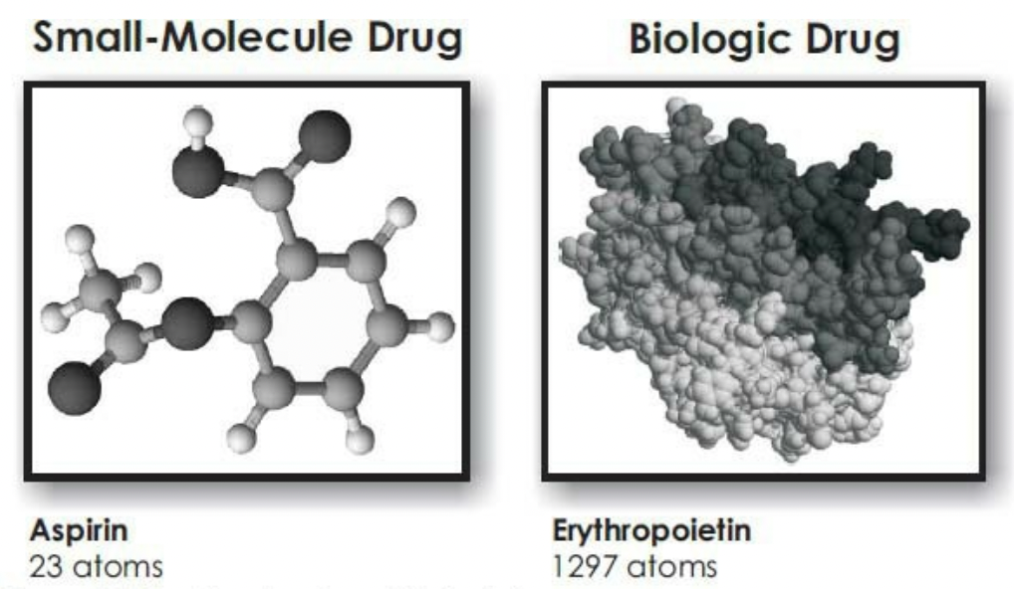
PHARMACEUTICAL VS. BIOTECHNOLOGY DRUG
traditional pharmaceutical drugs tend to be small molecules that are orally doseable as tablets, capsules, or liquids.
biotechnology drugs are proteins, such as growth factors, monoclonal antibodies, hormones, and cytokines. Other categories include nucleic acids and vaccines.
Biotechnology drugs are larger and more complex than traditional pharmaceutical drugs.
Drug delivery is an issue for biotechnology-derived drugs
Notes:
Following absorption in the gastrointestinal tract these drugs travel throughout the body in the bloodstream, and can often be mass-produced for a relatively low cost.
because proteins and other biotechnology drugs such as nucleic acids are less likely to survive the acidic conditions in the stomach and are generally unable to pass through the intestinal lining and travel the bloodstream to their therapeutic target. Biotechnology drug delivery techniques include injection, skin patches, and inhalation.

Slide 11
PHARMACEUTICAL VS. BIOTECHNOLOGY DRUG
Biosimilars vs. generic drugs
https://www.statnews.com/2019/02/05/biosimilars-biologics-explainer-video/

Slide 12
3. Breakthroughs In Biomedicine

Slide 13
Breakthroughs In Biomedicine
2001: Gleevec, first of a new class of drugs based on molecular biology (tyrosine kinase inhibitor), C₂₉H₃₁N₇O
2004: Avastin, angiogenesis inhibitor (VEGF), C₆₆₃₈H₁₀₁₆₀N₁₇₂₀O₂₁₀₈S₄₄
2006: Sutent, approved for RCC and GIST simultaneously, C₂₂H₂₇FN₄O₂
2008: First cancer genome (leukemia) sequenced by Wash U. Genome Institute, Nature 456 (2008):66-72.
2012: Dr. Lukas Wartman, Wash U. “cured” of acute lymphoblastic leukemia via RNA analysis and Sutent
2012: David Aponte “cured” of same type of leukemia using immunotherapy (T- cells targeting CD19)
2014: Keytruda approved, PD-1 immunotherapy
2017: Luxturna gene therapy approved for treating Leber’s congenital amaurosis
Notes:
Series of breakthroughs in biomedicine over the course of the last two decades:
2001: a new class of drugs based on molecular biology called GLEEVEC was approved by the FDA. It treats leukemia, by understanding the molecular biology of the disease and coming up with a chemical compound that focused exactly on that particular mechanism. It's a so-called designer drug. The particular kind of leukemia that this drug treats is chronic myelogenous leukemia. It's a blood disorder where your white blood cells reproduce uncontrollably and produce deformed white blood cells. They don't work properly, and they crowd out red blood cells, platelets, and other problems. Pretty much a death sentence. And so in 2001, a pair of scientists and clinicians came up with a particular chemical compound that they identified to disrupt the reproductive cycle of these cancerous white blood cells. And the chemical is 29 carbon atoms, plus 31 hydrogen atoms, plus 7 nitrogen atoms, and a single oxygen atom. Mix that together, give it to a chronic biologic leukemia patient, and presto, the disease is gone. Complete hematological response. Their blood count is normal after this drug.
2004: Avastin, angiogenesis inhibitor (VEGF), C6638H10160N1720O2108S44 Another drug that was the first of its kind was approved, a drug called Avastin. Now, this drug was designed to deal with cancer in a very different way. It was actually based on a hypothesis that was developed in 1971 by Judah Folkman. And he came up with a theory. And the theory was, tumors, cancerous tumors develop because they've got blood vessels that feed the tumor growth. So if somehow you can block the blood vessel's growth, you can starve the tumor, and shrink, and even wipe it out. That was in 1971. That hypothesis was demonstrated in 2004 with this drug, Avastin. Now the chemical formula for Avastin looks like this-- 6,638 atoms of carbon, and 10,000 atoms of hydrogen, and so on. It's a much, much bigger molecule. And it's a bigger molecule because it's actually a biological medicine. It's not a chemical compound, but rather it's grown in live cells. And it was the first of its kind, a biological medicine, used to retard the growth of blood vessels in tumors-- angiogenesis inhibitors. And it worked like a charm.
2006: Sutent, approved for RCC and GIST simultaneously, C22H27FN4O2: A smaller molecule, like GLEEVEC, was approved for treating renal cell carcinoma and gastrointestinal tumors.
2008 First cancer genome (leukemia) sequenced by Wash U. Genome Institute, Nature 456 (2008):66-72. In 2008, the very first leukemia genome was completely sequenced at Washington University in St. Louis.
2012: Dr. Lukas Wartman, Wash U. "cured" of acute lymphoblastic leukemia via RNA analysis and Sutent: And in 2012, something really interesting occurred with this particular individual, a fellow by the name of Lukas Wartman, who was actually a researcher at Wash U's Genome Institute. Turns out that Wartman had experienced a particular kind of leukemia years before, called acute lymphoblastic leukemia. Unlike acute myelogenous leukemia, this type of leukemia kills in a matter of months. And so when he was diagnosed with it several years before, he had to be treated very aggressively. And for a time, it went into remission. And then when he was a medical student, it came back. And they treated again with a bone marrow transplant from his brother, chemotherapy, and so on. And it went away for a while.
And it came back a second time. Now when he had a second recurrence of this disease, his doctors told him, you should get your affairs in order and start saying goodbye to your friends and family, because the probability of survival with a first-time recurrence is about 5% over a five-year period. They didn't have statistics for the probability of survival of a second recurrence, because there were so few people that actually lived to see a second recurrence. And so he started putting his affairs in order.
But it turns out that his friends happened to be researchers at Washington University's Genome Institute. So what did they do? They decided not to leave any stone unturned, not to take this lying down. 24/7 all-out effort, they decided to sequence everything they could about Lukas Wartman. They sequenced his normal, healthy cells. They sequenced his DNA. The sequenced the cancer cell's DNA. They sequenced the RNA, which is typically not something that you do in these kind of therapies. But when they did that, they found a particular gene that was over-expressed. And so they used high throughput screening methods, large amounts of data, and searched through the data to find a chemical compound that would suppress this gene, FLT3. And they found it. They found the compound. You know what that compound was? Turns out it was SUTENT, this kidney cancer drug. Now SUTENT is not approved for leukemia, but we knew that it was safe because it had gone through clinical trials. And so they gave Dr. Wartman this drug. Within days, he was feeling better. And weeks later, he's back at work. And today, they can no longer detect any leukemia cells in his body. For all intents and purposes, he is cured. Remarkable story. And now, SUTENT, now it's approved for treating this particular disease. But it certainly wasn't when he came down with it.
2012: David Aponte "cured" of same type of leukemia using immunotherapy (T- cells targeting CD19) And around the same time, somebody named David Aponte, who is an ABC News sound crew technician, came down with acute lymphoblastic leukemia as well. Now, he didn't have friends at Wash U's Genome Institute, so he didn't know that SUTENT worked. But his doctors decided to try a completely new therapy that involved using David's own T cells to fight the cancer. So they took T cells out of his body, decided to change it around a bit to be able to identify the cancer cells, and put it back in his body. And once again, within weeks, he was back at work and now no longer being treated for the disease. It seems like he was cured too, with a completely different mechanism.
2014: Keytruda approved, PD-1 immunotherapy
2017: Luxturna gene therapy approved for treating Leber's congenital amaurosis
And the last example that I want to give you is what happened few years ago. And that example has to do with these two kids, Caroline and Cole Carper-- happy kids that were born with an unfortunate genetic condition that was introduced by their parents. Both parents had this particular genetic mutation. And that meant that this gene was going to be expressed in their kids with 100% probability. They didn't know it at the time. But this particular mutation creates a condition known as Leber Congenital Amaurosis. And it's a condition that causes blindness from birth. You're born able to see, but because of this mutation you start losing the ability to see because of some problems with the retina and how it develops. And after six months, you're pretty much blind. Scientists have now figured out a way to introduce the correct gene into a virus, inject the virus into the back of the eye, and the virus will now incorporate that gene into the cells that create these rods and cones. And a one-time therapy can now change this condition to allow people who are blind from birth to see. This therapy, this gene therapy, was approved few years ago. It's called LUXTURNA, by Spark Therapeutics. And Caroline and Cole were part of the original clinical trial.
And let me read to you what Caroline said about her experience. "I went outside when it was snowing, and I was like, oh, I can see the snowflakes. It was really cool to actually see something that I've never seen in my life before. I was blind, and now I see." You know that's the kind of phrase you would usually hear from a religious experience. We're doing this now. Doctors and scientists can now restore sight. This is what it means to be at an inflection point in biomedicine.

Slide 14
Breakthroughs In Biomedicine
2001: Gleevec, first of a new class of drugs based on molecular biology (tyrosine kinase inhibitor), C₂₉H₃₁N₇O
2004: Avastin, angiogenesis inhibitor (VEGF), C₆₆₃₈H₁₀₁₆₀N₁₇₂₀O₂₁₀₈S₄₄
2006: Sutent, approved for RCC and GIST simultaneously, C₂₂H₂₇FN₄O₂
2008: First cancer genome (leukemia) sequenced by Wash U. Genome Institute, Nature 456 (2008):66-72.
2012: Dr. Lukas Wartman, Wash U. “cured” of acute lymphoblastic leukemia via RNA analysis and Sutent
2012: David Aponte “cured” of same type of leukemia using immunotherapy (T- cells targeting CD19)
2017: Luxturna gene therapy approved for treating Leber’s congenital amaurosis
Notes:
Series of breakthroughs in biomedicine over the course of the last two decades:
2001: a new class of drugs based on molecular biology called GLEEVEC was approved by the FDA. It treats leukemia, by understanding the molecular biology of the disease and coming up with a chemical compound that focused exactly on that particular mechanism. It's a so-called designer drug.
The particular kind of leukemia that this drug treats is chronic myelogenous leukemia. It's a blood disorder where your white blood cells reproduce uncontrollably and produce deformed white blood cells. They don't work properly, and they crowd out red blood cells, platelets, and other problems. Pretty much a death sentence.
And so in 2001, a pair of scientists and clinicians came up with a particular chemical compound that they identified to disrupt the reproductive cycle of these cancerous white blood cells. And the chemical is 29 carbon atoms, plus 31 hydrogen atoms, plus 7 nitrogen atoms, and a single oxygen atom. Mix that together, give it to a chronic biologic leukemia patient, and presto, the disease is gone. Complete hematological response. Their blood count is normal after this drug.
2004: Avastin, angiogenesis inhibitor (VEGF), C6638H10160N1720O2108S44 Another drug that was the first of its kind was approved, a drug called Avastin.
In 1971 Judah Folkman formulated the theory that, tumors, cancerous tumors develop because they've got blood vessels that feed the tumor growth. So if somehow you can block the blood vessel's growth, you can starve the tumor, and shrink, and even wipe it out.
That hypothesis was demonstrated in 2004 with this drug, Avastin. Now the chemical formula for Avastin looks like this-- 6,638 atoms of carbon, and 10,000 atoms of hydrogen, and so on. It's a much, much bigger molecule. And it's a bigger molecule because it's actually a biological medicine. It's not a chemical compound, but rather it's grown in live cells. And it was the first of its kind, a biological medicine, used to retard the growth of blood vessels in tumors-- angiogenesis inhibitors. And it worked like a charm.
2006: Sutent, approved for RCC and GIST simultaneously, C22H27FN4O2: A smaller molecule, like GLEEVEC, was approved for treating renal cell carcinoma and gastrointestinal tumors.
2008 First cancer genome (leukemia) sequenced by Wash U. Genome Institute, Nature 456 (2008):66-72. In 2008, the very first leukemia genome was completely sequenced at Washington University in St. Louis.
2012: Dr. Lukas Wartman, Wash U. "cured" of acute lymphoblastic leukemia via RNA analysis and Sutent: And in 2012, something really interesting occurred with this particular individual, a fellow by the name of Lukas Wartman, who was actually a researcher at Wash U's Genome Institute. He experienced a particular kind of leukemia called acute lymphoblastic leukemia. It was treated very aggressively with a bone marrow transplant from his brother, chemotherapy, and so on. And it went away for a while.
And it came back a second time. Now when he had a second recurrence of this disease, his doctors told him, you should get your affairs in order and start saying goodbye to your friends and family, because the probability of survival with a first-time recurrence is about 5% over a five-year period. They didn't have statistics for the probability of survival of a second recurrence, because there were so few people that actually lived to see a second recurrence. And so he started putting his affairs in order.
But it turns out that his friends happened to be researchers at Washington University's Genome Institute. So what did they do? They decided 24/7 all-out effort to sequence everything they could about Lukas Wartman. They sequenced his normal, healthy cells. They sequenced his DNA. The sequenced the cancer cell's DNA. They sequenced the RNA, which is typically not something that you do in these kind of therapies.
They found a particular gene that was over-expressed. And so they used high throughput screening methods, large amounts of data, and searched through the data to find a chemical compound that would suppress this gene, FLT3. And they found it. They found the compound. You know what that compound was? Turns out it was SUTENT, this kidney cancer drug.
Now SUTENT is not approved for leukemia, but we knew that it was safe because it had gone through clinical trials. And so they gave Dr. Wartman this drug. Within days, he was feeling better. And weeks later, he's back at work. And today, they can no longer detect any leukemia cells in his body. For all intents and purposes, he is cured. Remarkable story. And now, SUTENT, now it's approved for treating this particular disease. But it certainly wasn't when he came down with it.
2012: David Aponte "cured" of same type of leukemia using immunotherapy (T- cells targeting CD19) And around the same time, somebody named David Aponte, who is an ABC News sound crew technician, came down with the same disease (i.e. acute lymphoblastic leukemia). He didn't know that SUTENT worked.
His doctors decided to try a completely new therapy that involved using David's own T cells to fight the cancer. So they took T cells out of his body, decided to change it around a bit to be able to identify the cancer cells, and put it back in his body.
Within weeks, he was back at work and now no longer being treated for the disease. It seems like he was cured too, with a completely different mechanism.
2014: Keytruda approved, PD-1 immunotherapy
2017: Luxturna gene therapy approved for treating Leber's congenital amaurosis
And the last example that I want to give you is what happened few years ago. And that example has to do with these two kids, Caroline and Cole Carper-- happy kids that were born with an unfortunate genetic condition that was introduced by their parents. Both parents had this particular genetic mutation. And that meant that this gene was going to be expressed in their kids with 100% probability. They didn't know it at the time. But this particular mutation creates a condition known as Leber Congenital Amaurosis. And it's a condition that causes blindness from birth.
Scientists have now figured out a way to introduce the correct gene into a virus, inject the virus into the back of the eye, and the virus will now incorporate that gene into the cells that create these rods and cones. And a one-time therapy can now change this condition to allow people who are blind from birth to see. This therapy, this gene therapy, was approved few years ago. It's called LUXTURNA, by Spark Therapeutics. And Caroline and Cole were part of the original clinical trial.

Slide 15
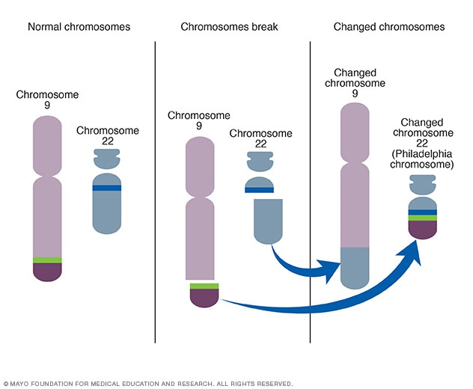
Chronic myelogenous leukemia

Slide 16
How Gleevec work
Is an inhibitor of enzymes
Does not change the gene
https://dnalc.cshl.edu/resources/3d/32-how-gleevec-works.html

Slide 17
Biomedicine Is At An Inflection Point
Dec 19, 2017
“I went outside when it was snowing, and I was like, ‘Oh! I can see the snowflakes!’…It was really cool to actually see something that I've never seen in my life before.”
Notes:
This is what Caroline said about her experience
Doctors and scientists can now restore sight. This is what it means to be at an inflection point in biomedicine.

